Slide 1
REFLEXIVITY AND THE PERPETUATION OF INEQUALITY IN THE CULTURAL SECTOR: HALF AWAKE IN A FAKE EMPIRE
Eleonora Belfiore and Steven Hadley (with Brea Heidelberg & Carole Rosenstein)

Slide 2
OUR ARGUMENT:
The discourses of cultural democracy, cultural equity and cultural diversity have sought to address broad policy issues around production, consumption and representation in the US and UK.
We argue that these concepts have failed in their challenge to the long-established power dynamics of the cultural sector, as current data on both participation and production prove.
We posit that a self-reflexive approach is indispensable to counter the (non)performative behaviour of the cultural sector.
Without such an approach, initiatives supposedly designed to be culturally democratic risk reproducing structures of exclusion and facilitating a ‘non-performative woke democratisation of culture’.

Slide 3
TOO MANY CULTURAL POLICY INITIATIVES ARE ‘NON-PERFORMATIVE’
Sara Ahmed (2012), J.L. Austin (1975) and Judith Butler (1990).
These authors have been pivotal in developing and establishing the concept of language as not only describing reality but bringing it into being.
As Loxley (2007, 2) explains, ‘words do something in the world’, and utterances ‘are actions in themselves, actions of a distinctively linguistic kind’, and they ‘make a difference in the world; it could be said that they produce a different world, even if only for a single speaker and a single addressee’.

Slide 4
On the performativity of gender:
‘[g]ender reality is performative which means, quite simply, that it is real only to the extent that it is performed’, and that ‘[a]s performance which is performative, gender is an ‘act’, broadly construed, which constructs the social fiction of its own psychological interiority’
(Butler 1990, 278-9).

Slide 5
The shared guiding ethos of cultural democracy, cultural equity and the impetus to ‘diversify’ culture is the promotion of cultural opportunities of varying natures. Yet how this ethos is understood and meant to be achieved varies between the concepts.
In the UK, under the rubric of cultural democracy, the focus is on cultural value and attendant questions of cultural authority, power, voice, and representation (Belfiore 2020).
In the US, the cultural equity agenda places the focus on representative distribution of resources to address long-standing inequalities, and the privileging of bureaucratic logics that push questions of cultural authority to the background.
‘Diversity’ has been pursued (with limited success) with the purpose of redressing the imbalance of representation of minoritized groups in production, distribution and consumption of both publicly subsidised and commercially produced cultural forms (Gray 2016; Gregory 2019; Moss 2005; Saha 2017).

Slide 6
The Failure of Successive Policy Approaches to Achieve Their Goals
The 1976 publication of Naseem Khan’s landmark report The Arts that Britain Ignores, which revealed a whole world of cultural activities that official culture ignored:
Some were dismissed as “community art”, some were dismissed as not art at all, but the report made a strong case for the proper recognition not just of black and Asian, but Balkan and Eastern European cultural expression. The term “ethnic” was introduced to replace the pejorative “minority”, or provocative “black” arts, but in practice became another racial euphemism (Hewison 2018, 149).
‘Contemporary public cultural policy is not adapted to major transformation processes in contemporary Western societies. Are we now facing the end of modern cultural policy?’
(Mangset 2020, 399)

Slide 7
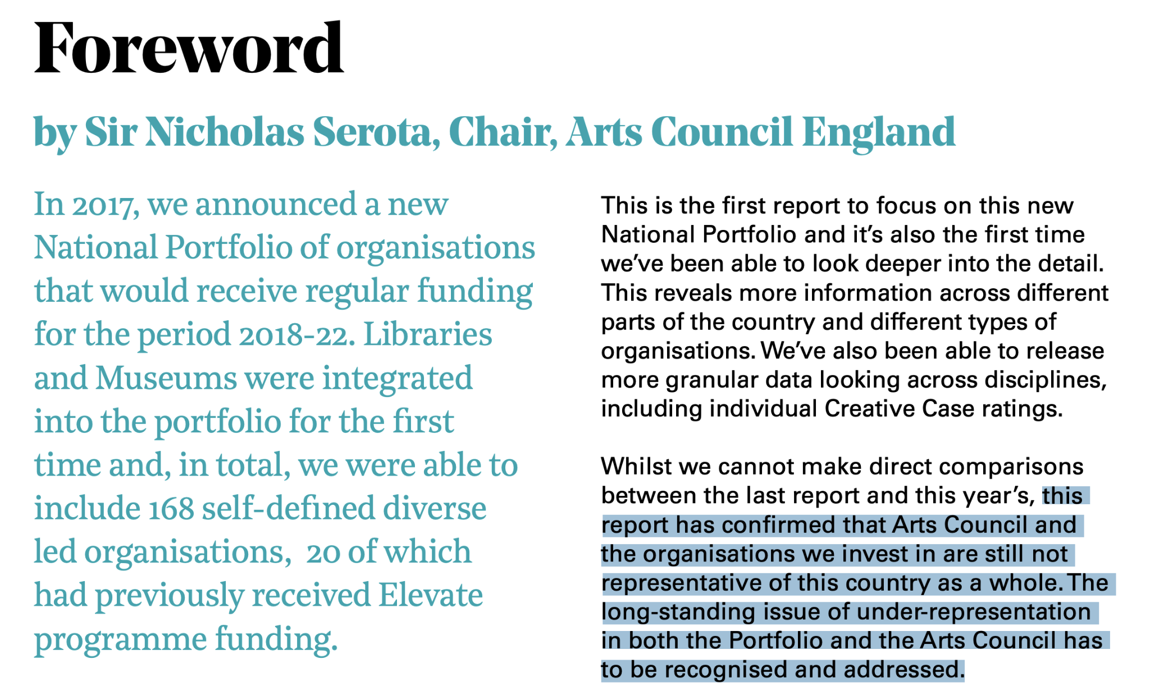
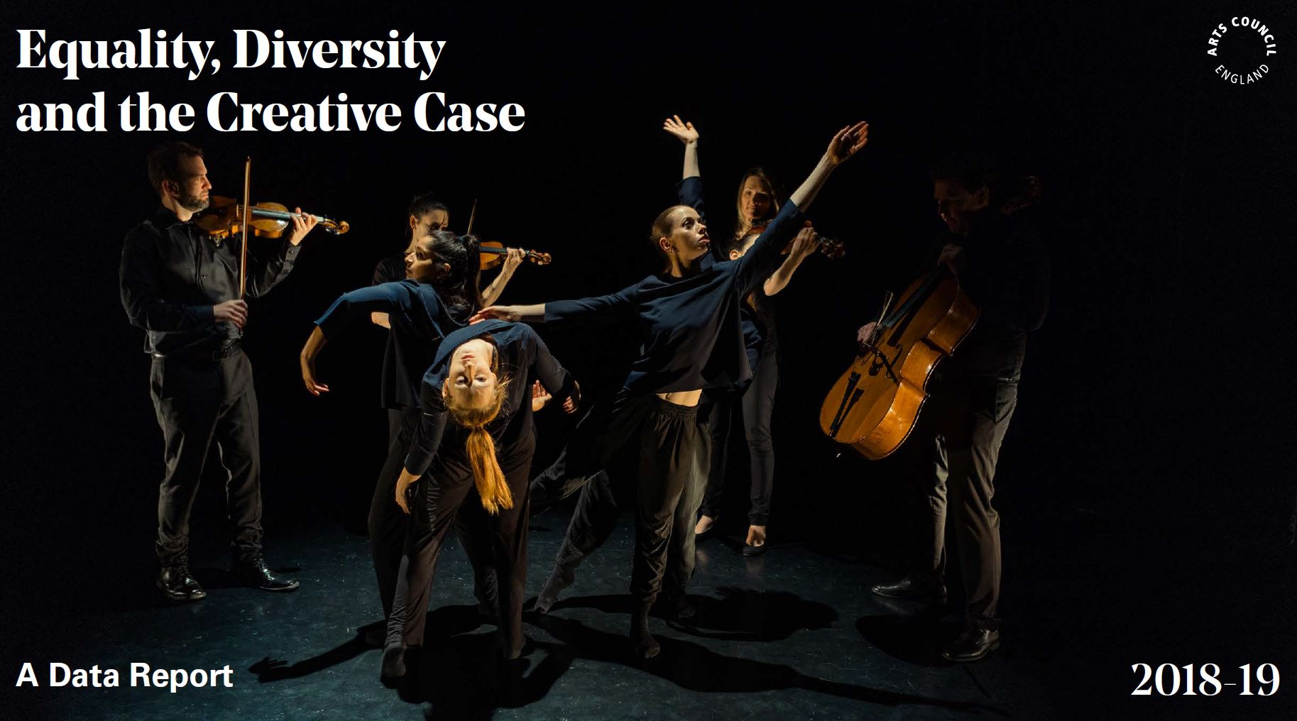

Slide 8
Dowling (2006) identifies a range of different forms of reflexivity:
‘epistemological reflexivity’
reflexivity based on the ‘politics of location’
reflexivity from a feminist standpoint, focused on ‘positioning’
How could a self-reflexive approach counter the (non)performative behaviour of the cultural sector and perpetuation of inequality?

Slide 9
Why have policies for cultural democracy, equity and diversity failed, despite numerous schemes, funding streams, policy reports and initiatives in the past 50+ years?
Why so little change?
‘Statements of commitment are non-performatives: they do not bring about the effects they name’ (Ahmed 2012, 17).

Slide 10
Because saying we want change and holding a roundtable about it is not making change.
Because those with privilege don’t just give it away - unless they are made to.
Because those at the helm of organisations and those doing the work of equality, diversity and inclusion often have a vested interest in things staying the same.
Because more brown and black faces, and more working class accents in arts organisations only reinforce and reproduce the status quo, unless a ‘tipping point’ of power is reached. This ‘tipping point’ will never be reached in the present model of EDI work, as the failure of past policy shows.

Slide 11
The Woke Democratisation of Culture as ‘unhappy performative’
Signalling but not enacting change suggests a merely rhetorical and perfunctory adoption of democratic discourses through an approach as close to hegemonic culture as possible, but with enough activist rhetoric to be seen to be ‘doing something’.
To paraphrase Butler (1990), social justice in the arts is performative in that it is real only to the extent that it is performed, such that ‘[a]s performance which is performative, social justice is an ‘act’, broadly construed, which constructs the social fiction of the moderate white liberal’s psychological interiority’.

Slide 12
Arts sector diversity initiatives are self-consciously symbolic public acts which largely fail to make a difference in the world. As such, they are ‘a performance within a non-performative’.
Discourse without effective action – whether that be around class ceilings, social mobility or decolonisation – is meaningless virtue signalling that risks a potentially endless recursivity. The challenge for cultural equity is that you do not solve privilege by creating more, or a more equal share of, privilege.
Our provocation to the audience:
What are WE, as cultural policy researchers,
going to do about this?

Slide 13
