Slide 1
Development and Application of
The Cultural Policy Typology of Principled Value
A Policy Typology for the Arts and Culture
The Biennial Research Conference of the Center for Cultural Affairs
O’Neill School of Public and Environmental Affairs at Indiana University
Hsin-Ching Wu, PhD
June 7, 2021

Slide 2
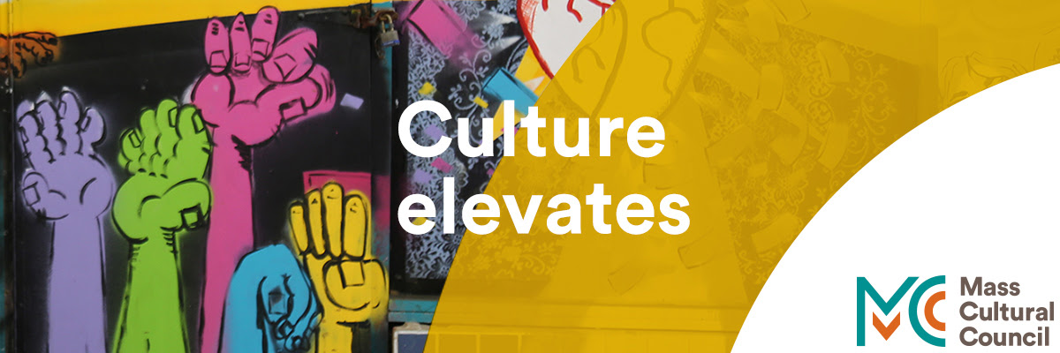
Presentation Outline
Background
Literature Review
Methods
Findings
Discussion and Conclusion

Slide 3
Background
The significance of the arts and culture in society, and yet continuous debate on their public value
Emerging interests in cultural policy in the U.S.
Under the decentralized U.S. federal system, states and municipalities, as the sub-national units of the government, play a major part in the ecology of the cultural sector
Notes:
Cooperative federalism (marble cake federalism)

Slide 4
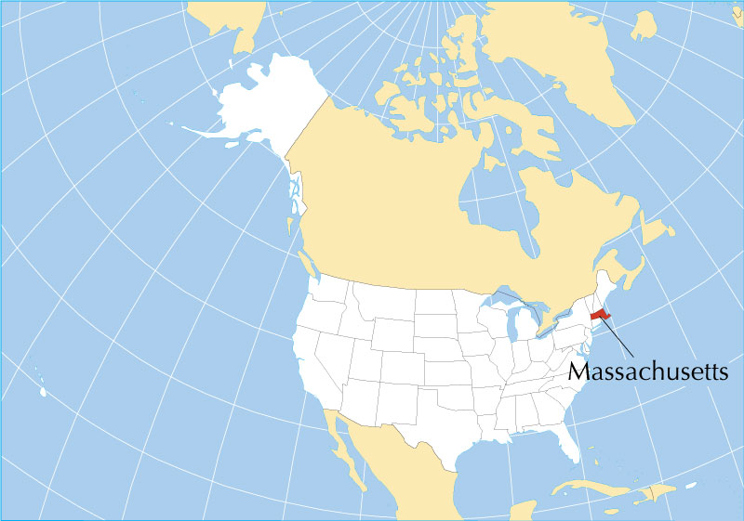
Background: Research Aims
Present a cultural policy typology based on goal variation
Examine its unitization in a case of study of a U.S. state art/cultural agency, the Massachusetts Cultural Council

Slide 5
Research Question
What are the policy goals of the Massachusetts Cultural Council?

Slide 6
Literature Review
Defining Governmental Actions in the Cultural Sector (Rentschler, 2002; Schuster et al., 2003)
Public Values of the Arts and Culture (DiMaggio, 1987; United Nations)
Economic Development Argument (Markusen & Schrock, 2006; Sterngold, 2004 )
Arts and Culture as Substantiable Development (UNESCO; Markusen & Gadwa, 2010)

Slide 7
Literature Review (continued)
The Need for a Specialized Cultural Policy Typology
Existing models of public policy typology (Lowi, 1964, 1972; Kellow, 1998; Wilson, cited in McCool, 1995, p. 246) are not sufficient or appropriate for analyzing the varying usage of culture
McCarthy et al. (2004) developed a framework to help understand the benefits of the arts by classifying them for individuals and communities
Research has been limited in terms of a specific typology that can be used to classify the governmental action in the arts and culture

Slide 8
Methods
As part of a larger study conducted between 2015-2017
Interviews with 15 individuals
9 individuals were further asked to score the MCC’s overall objectives using a 10-point scale in accordance with the presented typology
Interviews were coded to identify common, unexpected, and unusual categories/themes

Slide 9
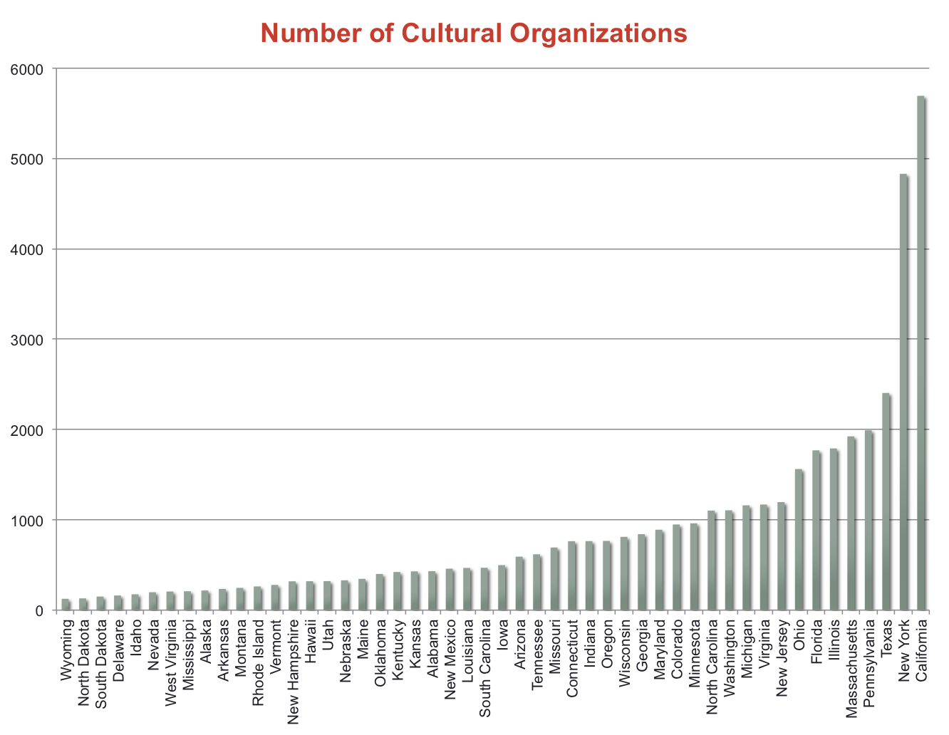
Methods (continued)
Case selection
Massachusetts has a sizable cultural sector
Notes:
This was not included in my paper today, but just to provide some context for this presentation. When the original study was first design, reportedly Massachusetts was among the top five states with the highest number of cultural organizations.

Slide 10
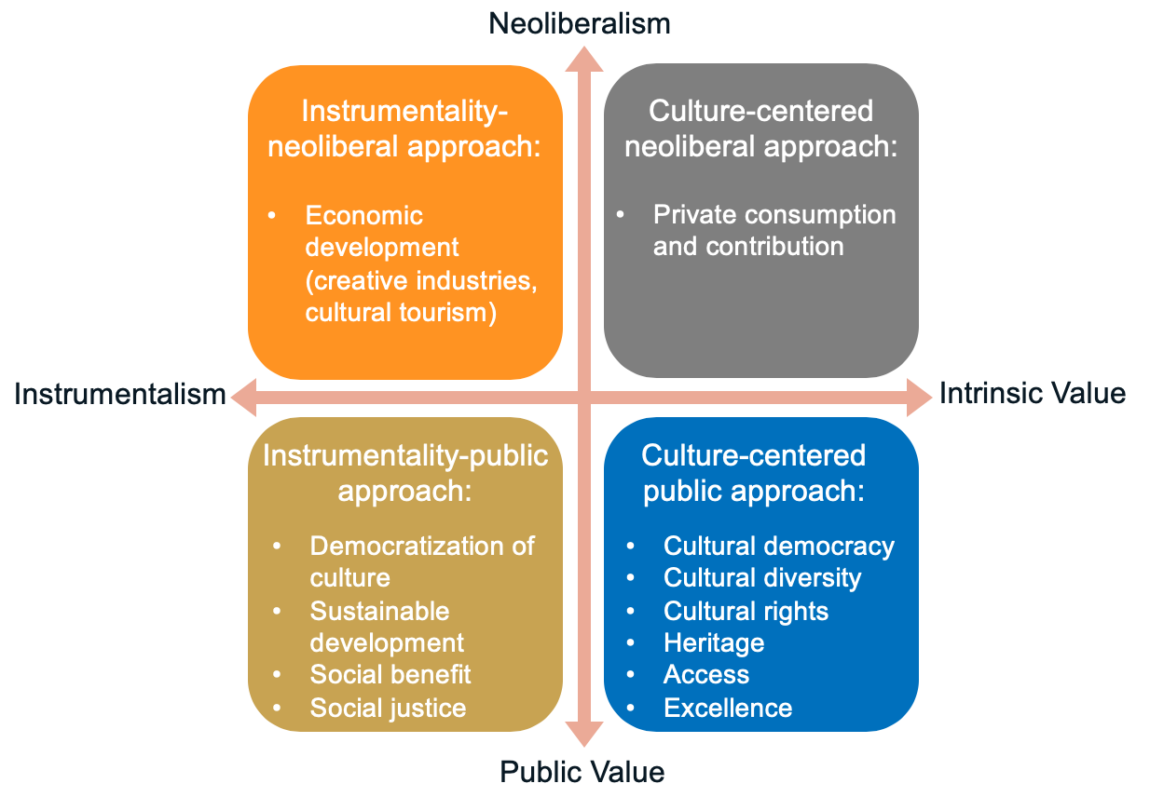
The Cultural Policy Typology of Principled Value

Slide 11
Findings
Types of Grant Programs Defined by the Cultural Policy Typology of Principled Value
Grant Program Name | Policy Goal | Nature of Grants | Grantee | Cultural Policy Typology
Adams Arts Program (since cancelled in 2017) | Economic development | Competitive | Organizations (project-based partnership, including municipalities) | Instrumentality-neoliberal approach
Artist Fellowships | Artistic quality | Competitive | Individuals | Culture-centered public approach
Big Yellow School Bus | Education | First-come-first-reviewed | Schools | Instrumentality-public approach
Cultural Facilities Fund (CFF) | Economic development | Competitive | Organizations (including municipalities and higher education institutions) | Instrumentality-neoliberal approach
Cultural Investment Portfolio (CIP) | Operating support | Formula based | Organizations (including higher education institutions) | Mixed: Instrumentality-neoliberal approach Instrumentality-public approach Culture-centered public approach
Festivals Program* | n/a | n/a | n/a | n/a
Local Cultural Council (LCC) Program | Local arts & culture | Formula based | Local councils | Culture-centered public approach
SerHacer | Youth development | Competitive | Organizations or schools | Instrumentality-public approach
STARS Residencies | Education | First-come-first-reviewed | Schools | Instrumentality-public approach
Traditional Arts Apprenticeships | Heritage | Competitive | Individuals | Culture-centered public approach
YouthReach | Youth development | Competitive | Organizations | Instrumentality-public approach

Slide 12
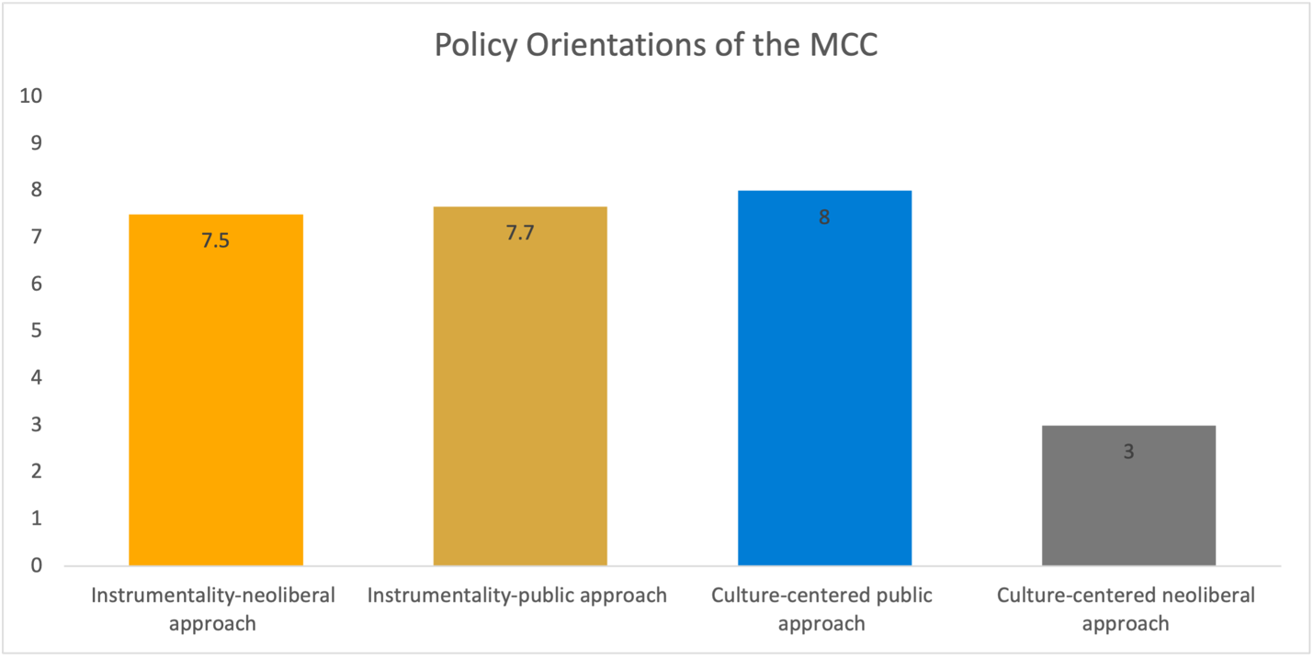
Findings (continued)
Policy Orientations of the MCC

Slide 13
Discussion
The MCC’s policy goals are rather broadly defined
The MCC was gradually moving away from instrumentality-neoliberalism
This policy shift may be a natural progression in the field as scholars have become more critical of the neoliberal policy of the government (McLean, 2014; Tochterman, 2012; Zimmerman, 2008)
The typology could be a very useful tool to help organizations to communicate their worth to public and private funders, the public, and other stakeholders in the community

Slide 14
Conclusion
The MCC’s policies could be categorized into the instrumentality-neoliberal, the instrumentality-public, and the culture-centered public approaches
The Cultural Policy Typology of Principled Value can help advance the knowledge of cultural policy decision making at all governmental levels

Slide 15
Thank You!
hw2918@nyu.edu
hsinching.wu@gmail.com
Scan to view my LinkedIn profile

Slide 16
References
DiMaggio, P. (1987). Can culture survive the marketplace? In P. DiMaggio (Ed.), Nonprofit enterprise in the arts: Studies in mission and constraint (pp. 67-92). Cary, NC: Oxford University Press.
Kellow, A. (1988). Promoting elegance in policy theory: Simplifying Lowi’s arenas of power. Policy Studies Journal, 16 (summer), 713-723. https://doi.org/10.1111/j.1541-0072.1988.tb00680.x
Lowi, T. (1964). American business, public policy, case studies, and political theory. World Politics, 16, 687-691. https://doi.org/10.2307/2009452
Lowi, T. (1972). Four systems of policy, politics, and choice. Public Administration Review, 33, 298-310. http://doi.org/10.2307/974990
Markusen, A. & Gadwa, A. (2010). Creative placemaking: Executive summary. Washington, DC: National Endowment for the Art. Retrieved from https://www.arts.gov/sites/default/files/CreativePlacemaking-Paper.pdf
Markusen A. & Schrock, G. (2006). The artistic dividend: Urban artistic specialization and economic development implications. Urban Studies, 43 (10), 1661-1686. https://doi.org/10.1080/00420980600888478
McCool, D. (1995). Discussion. In D. McCool (Ed.), Public policy theories, models, and concepts (pp. 244-250). Upper Saddle River, NJ: Prentice-Hill.
McCarthy, K. F., Ondaatje, E. H., Zakaras, L., & Brooks, A. (2004). Gift of the muse: Reframing the debate about the benefits of the arts. Santa Monica, CA: RAND.
Rentschler, R. (2002). The Entrepreneurial arts leader: Cultural policy, change and reinvention. Brisbane: University of Queensland Press
Schuster, J., Karraker D., Bonaiuto, S., Grogan, C., Rothfield, L., & Smith, S. R. (2003). Mapping state cultural policy: The state of Washington. Chicago, IL: Cultural Policy Center at the University of Chicago.
Sterngold, A. (2004). Do economic impact studies misrepresent the benefits of arts and cultural organizations. Journal of Arts management, Law, and Society, 34 (3), 166-187. https://doi.org/10.3200/JAML.34.3.166-187
United Nations Educational, Scientific and Cultural Organization. (2001). UNESCO Universal declaration on cultural diversity. Retrieve from http://portal.unesco.org/en/ev.php-URL_ID=13179&URL_DO=DO_TOPIC&URL_SECTION=201.html
United Nations Development Programmes. (1994). Human development report 1994. New York: Oxford University Press. Retrieved from

