Slide 1
An Investigation into the Impact of Social Media Practices on Collective Memory: An Evolution of the Conceptualisation of Women’s Experience in the Holocaust
Lior Misano
University College London

Slide 3
To be born by chance To be born by chance To be born a woman To be born poor To be born Jewish It’s too much For a single life
from Versi Vissuti
Edith Bruck

Slide 4
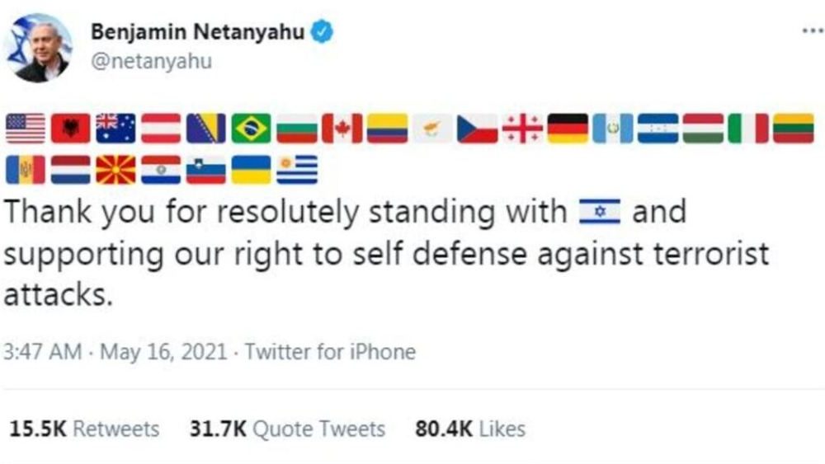

Slide 5
Collective Memory
Indicates the shared memory or set of memories of an experience lived or mythologized by a living community that is significantly associated with the group's identity (Nora 1989).
Cultural memory
It indicates a type of memory that is not based solely on a lived experience but is influenced by social interactions, it is formed by the interaction of past and present with socio-cultural and historical contexts (Erll and Nünning 2008).

Slide 12
